Slide 1
Regression
Sadia Islam Lecturer
Department of Computer Science and engineering United International University

Slide 2
Regression
Regression is used to understand the relationship between independent and dependent variables. It works with labelled data. e.g. linear regression
Maps input to output where output is
  Numerical
  Real
  Continuous

Slide 3
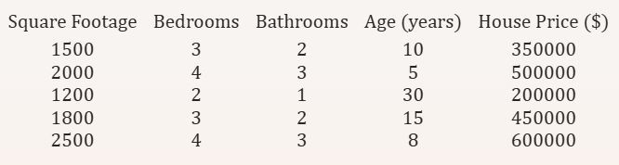
Regression Example
Example of predicting house prices based on square footage, number of bedrooms, number of bathrooms, and age of the house.

Slide 4
Linear Regression
Linear regression is a method to predict a dependent variable (Y) using one or more independent variables (X) by drawing a straight line through the data.
Simple Linear Regression
Multiple Linear Regression
Multivariate Linear Regression
Main Idea:
Fit a line that best predicts Y based on X.
Minimize the distance between the real data and the predicted line.
4 Simple Assumptions:
Straight Line: Relationship between X and Y is linear. Independent Data: Data points don’t affect each other. Equal Spread: Errors are evenly spread out (no patterns). Normal Errors: Errors follow a normal distribution.
Why Use It?:
Predict outcomes (e.g., exam scores based on study hours). Find simple relationships in data.

Slide 5
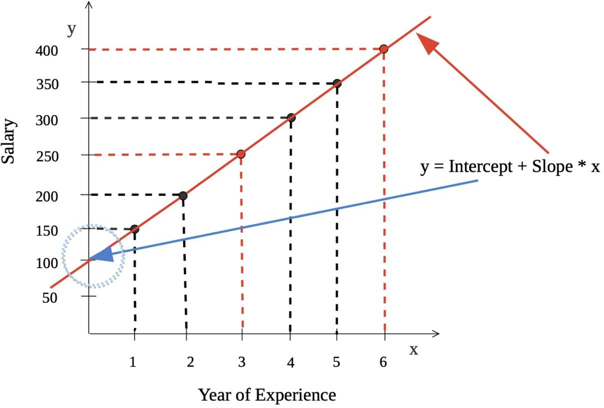
Simple Linear Regression
One input variable (X) and one output variable(Y)
Mapping X to Y using a line
y = ω0 + ω1.x
We need to find ω0 and ω1

Slide 6




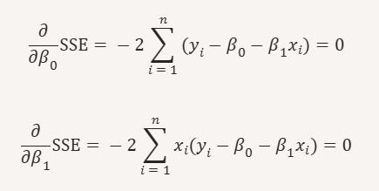
Simple Linear Regression Cont.

Slide 7


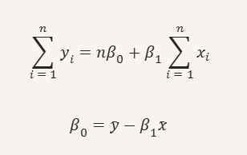
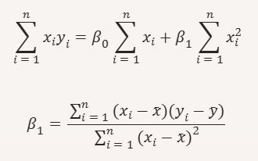
Simple Linear Regression Cont.
From the two equations:

Slide 8
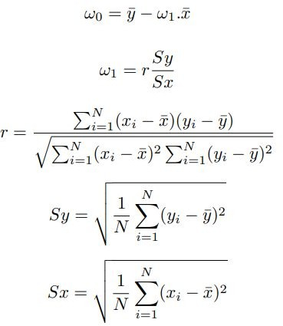
Simple Linear Regression Cont.
Correlation Coefficient,
The standard deviation is calculated as the square root of variance by determining each data point’s deviation relative to the mean.

Slide 9
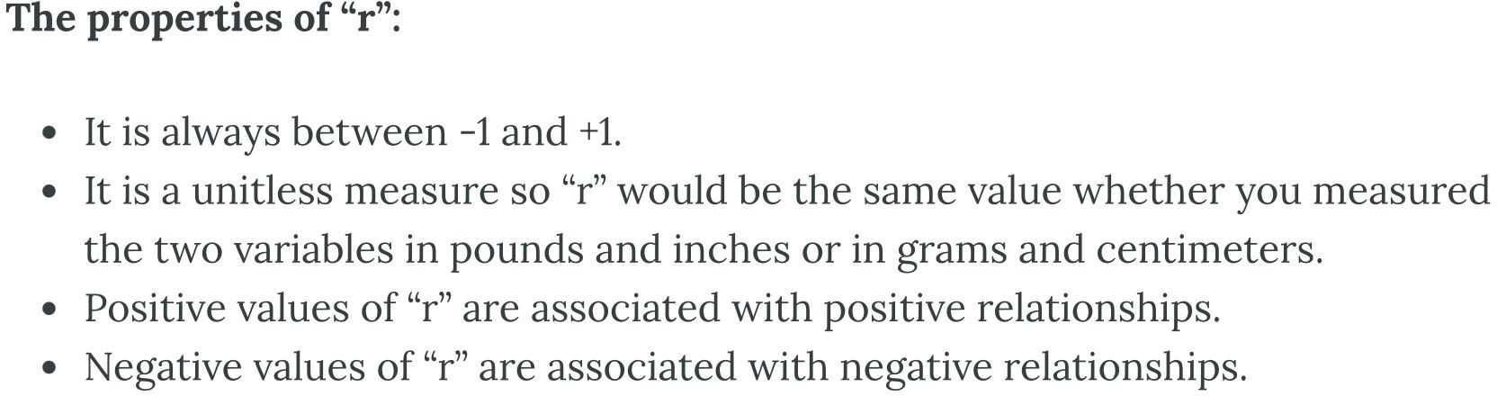
Linear Correlation Coefficient
Because visual examinations are largely subjective, we need a more precise and objective measure to define the correlation between the two variables. To quantify the strength and direction of the relationship between two variables, we use the linear correlation coefficient:

Slide 10
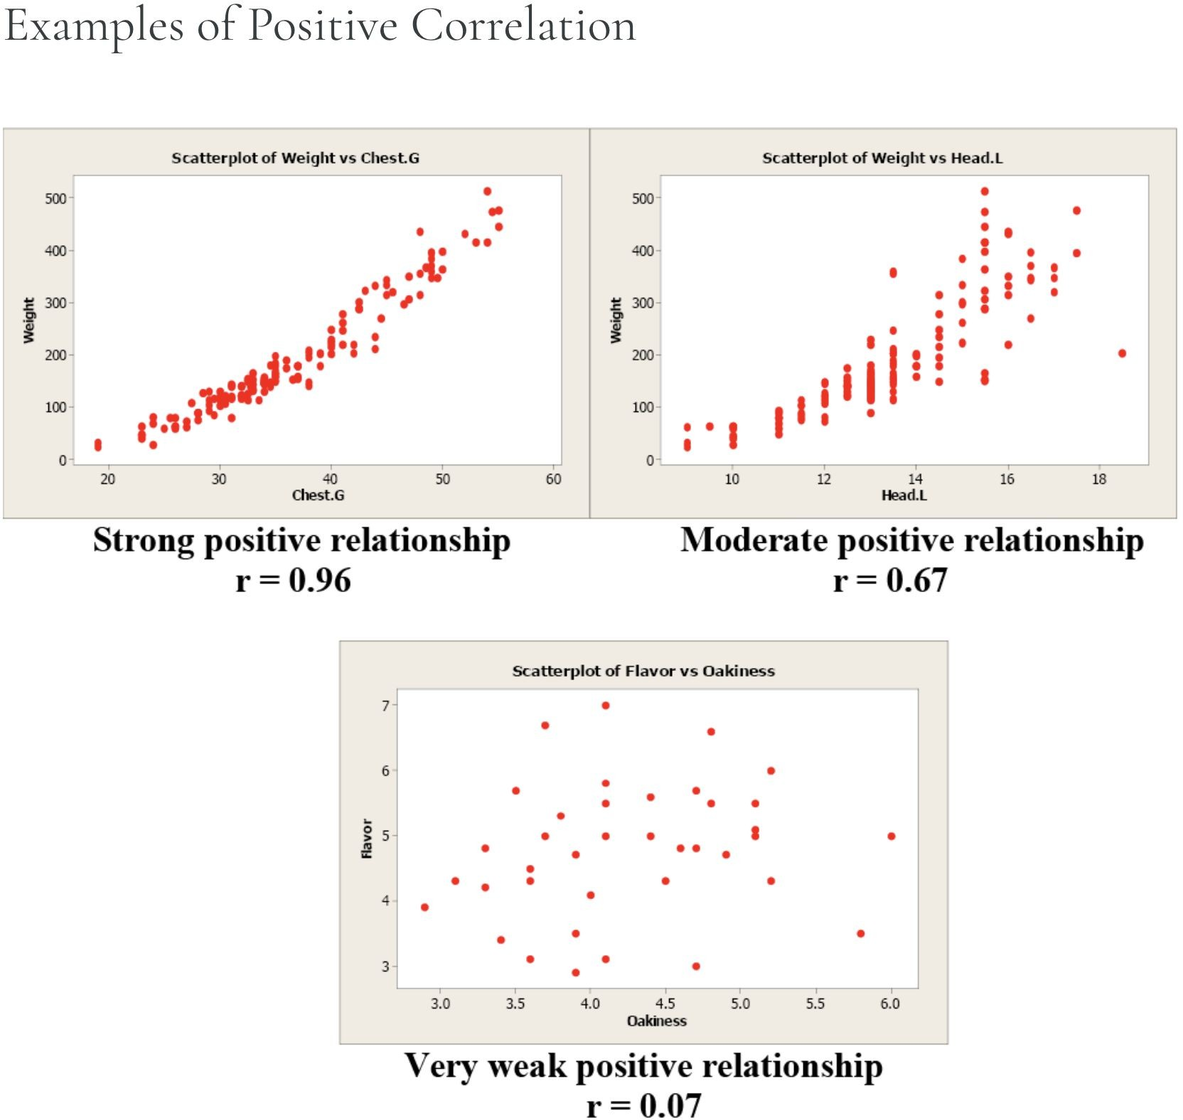
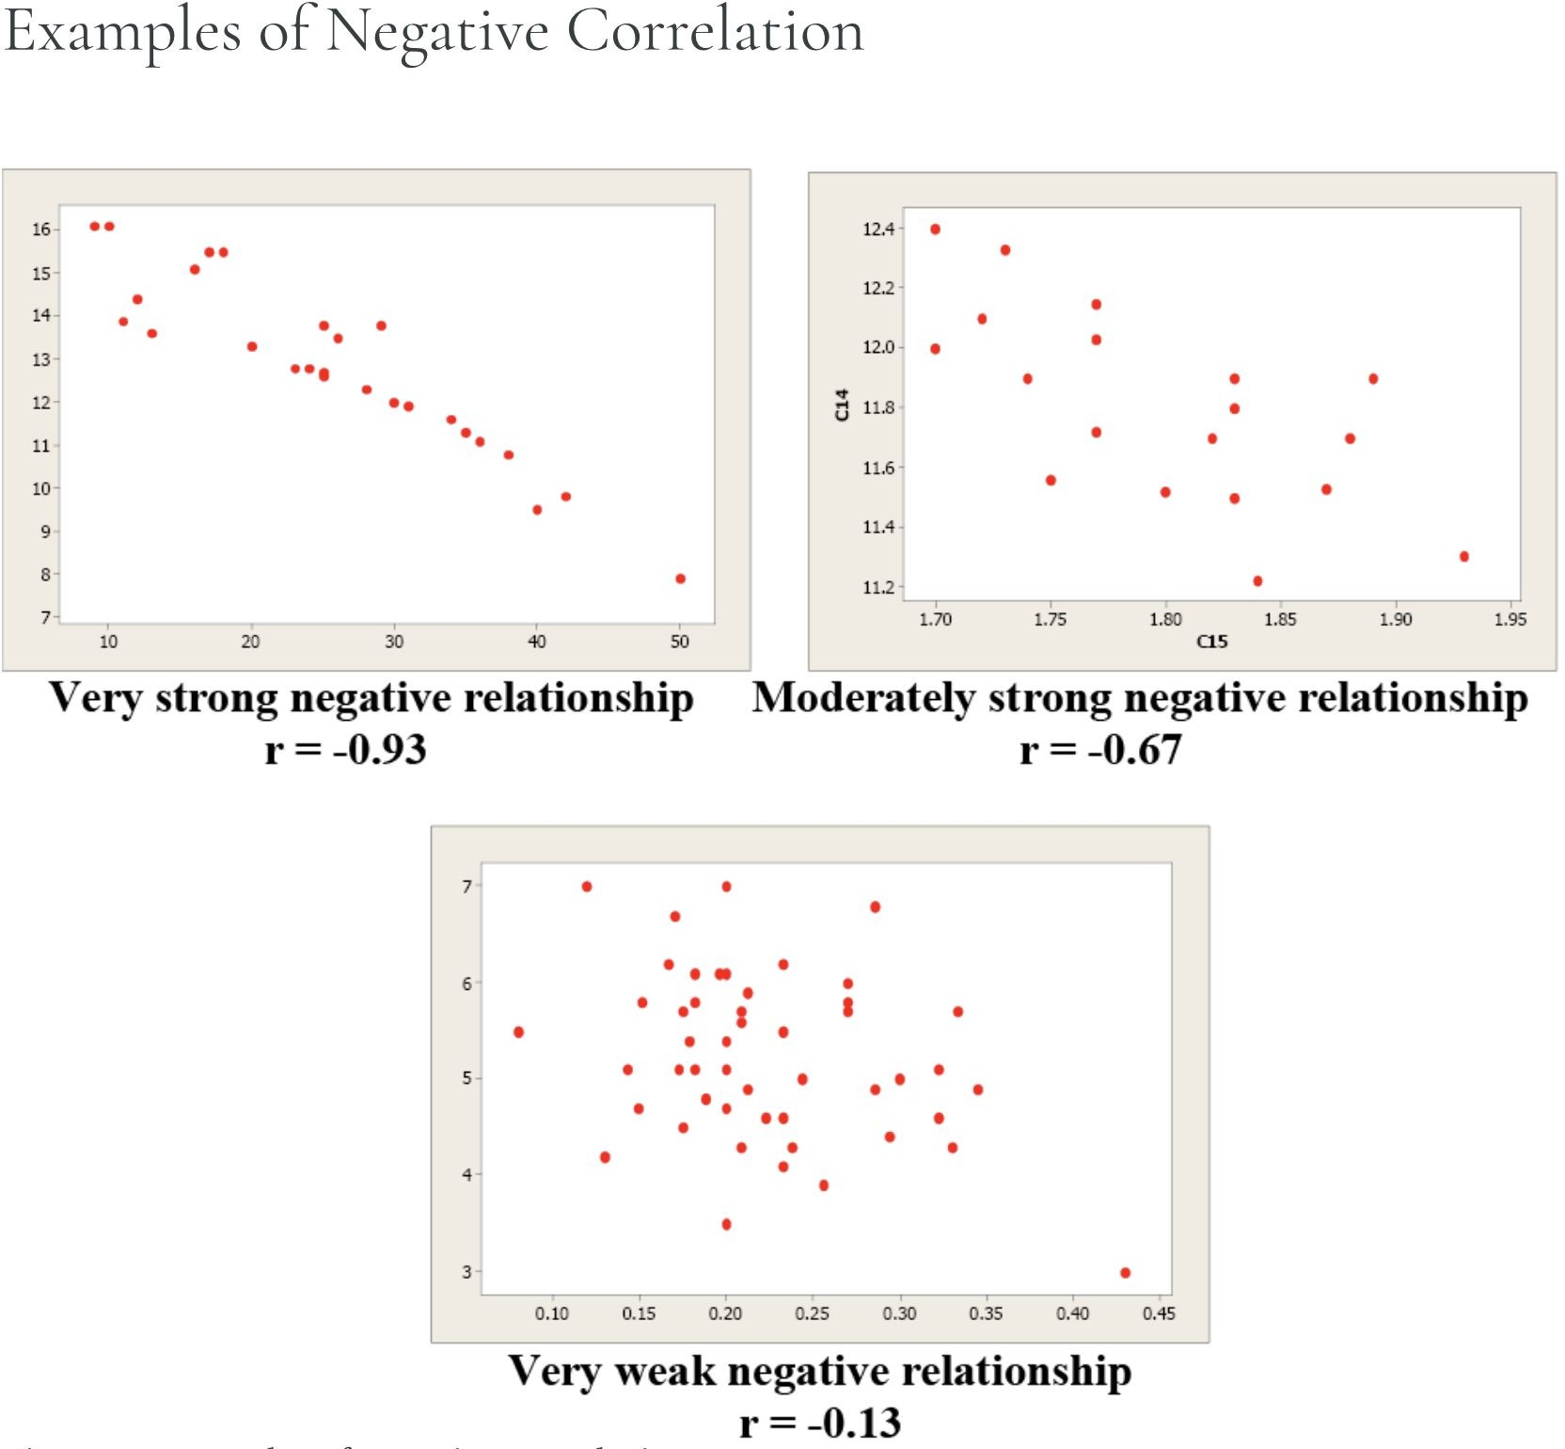
Notes:
r=0 is bad because it indicates that there is no positive and negative relationship

Slide 11
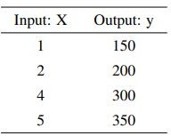
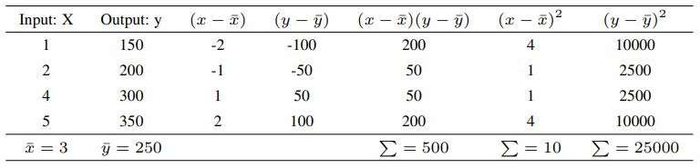
Simple Linear Regression - Example

Slide 12





Simple Linear Regression - Example

